Slide 1


Sound and Light
Jenny Cox
Visit www.worldofteaching.com
For 100’s of free powerpoints

Slide 2

Why is the sky blue?
and
Why are sunsets red?

Slide 3
Laboratory: How Sound Travels
Part I: Does sound travel through paper, plastic, metal, and water?
Part II: Which medium does sound travel best in: air, water, or wood?
Part III: Do sound waves have to have a medium to travel through?

Slide 4
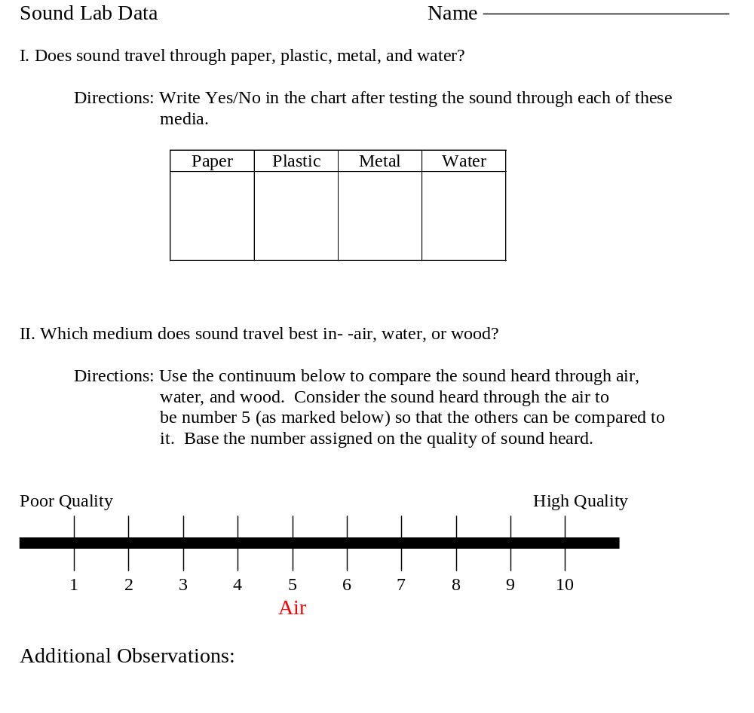

Slide 5
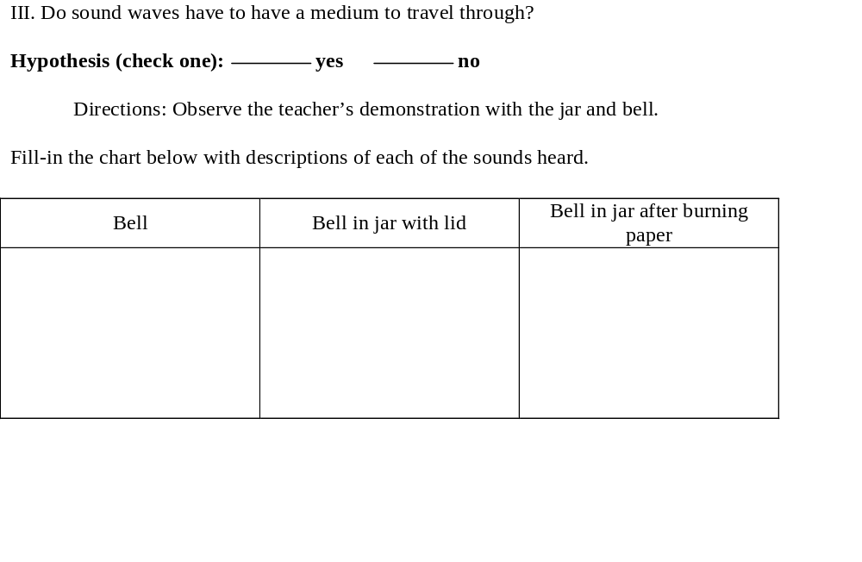

Slide 6
Demonstrations
Sight and Light
Heart: After-image
Sound Wave Demo + marbles
Straw Whistle/Recorder
Stations

